Slide 1
King County, Washington
Real Estate Development Recommendations
May 13, 2022
Argon Team:
John Bruemmer
Woojin Jun
Nazar Mohl

Slide 2
Study Goals
Advise Real Estate Developer Using trends in Real Estate Prices in King County to determine
Optimal locations to develop
Profitable house configurations

Slide 3
Available Data
King County House Sales dataset
`price` - Sale price (prediction target)
`bedrooms` - # of bedrooms
`bathrooms` - # of bathrooms
`sqft_living` - Square footage of living space in the home
`zipcode` - USPS ZIP Code
`long` - Longitude coordinate
REMOVED: Redundant, Null and Irrelevant data
DERIVED: ‘price per sqft’
John’s Zipcode Mean Income Info
Notes:
Unused data columns: `id`, `date`, `sqft_lot`, `floors`, `waterfront`, `view`, `condition`, `grade`, `sqft_above`, `sqft_basement`, `yr_built`, `yr_renovated`, `lat`, `sqft_living15`, `sqft_lot15`

Slide 4
Modeling
Least Squares Regression
R Squared
Target:
Selling Price
Predictors:
`bedrooms`, `bathrooms`, `sqft_living`

Slide 5
Regression Results

Slide 6
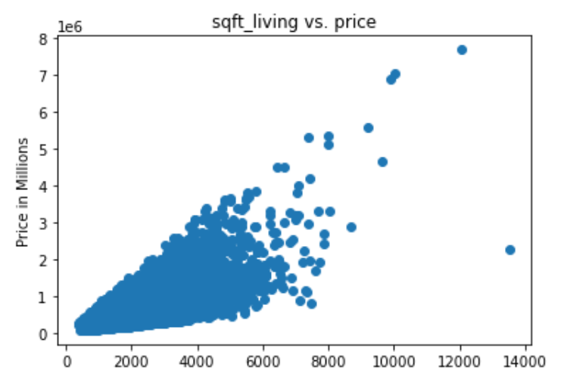
Price vs. Sq Ft Living Space

Slide 7
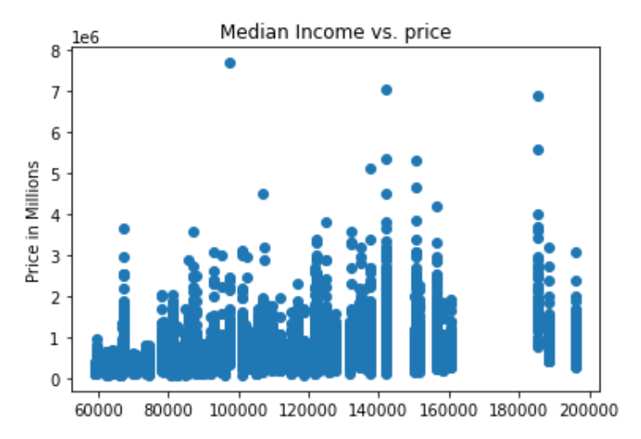
Price vs. Median Income of Zip Code
Using Median income to approximate the desirability of a location.
For each $1 increase in avg income, the cost of a house increases $3.34.

Slide 8
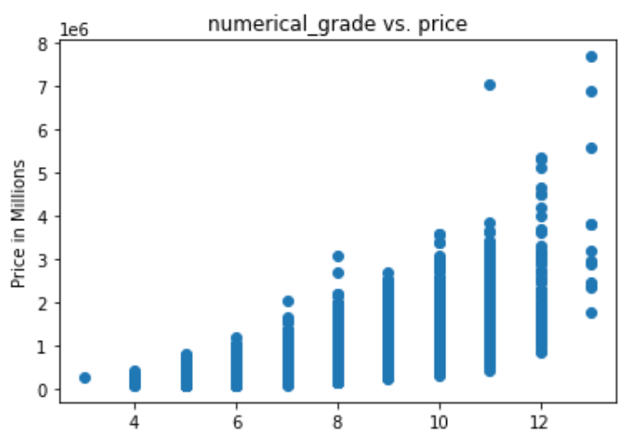
Price vs. Overall Grade of House

Slide 9
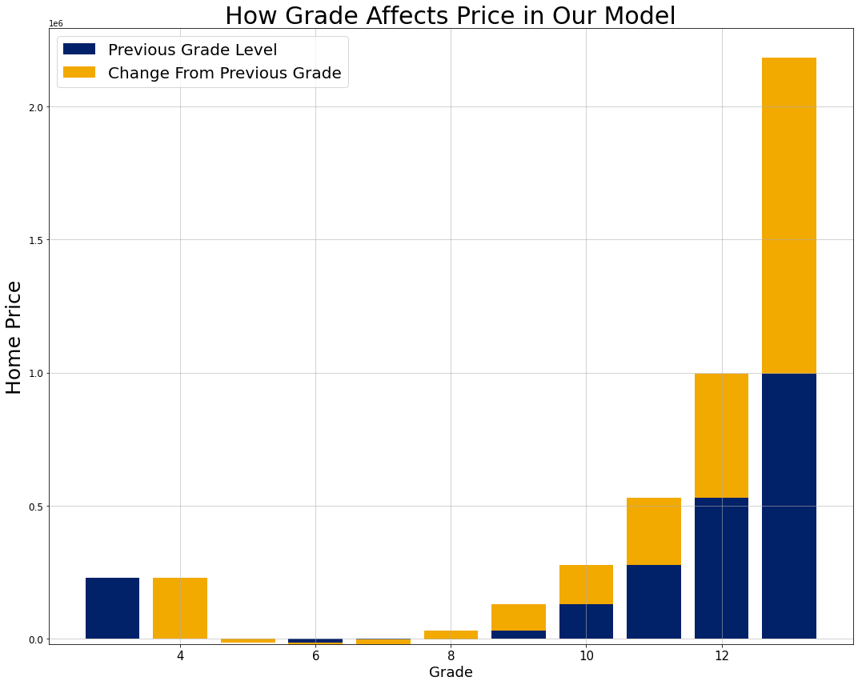
Effect of Grade on House Price
Develop properties with above average or very high overall grade
Increase in price across upper grades is exponential
If increase in costs across grades is linear, then focus on upper grades.

Slide 10
Recommendations
Develop properties with highest overall grade given the location.
Upgrade properties to higher grade level may yield significant profit.

Slide 11
Recommendations
Location
View
Waterfront

Slide 12
Next Steps

Slide 13
Q&A
Thank You

Slide 14
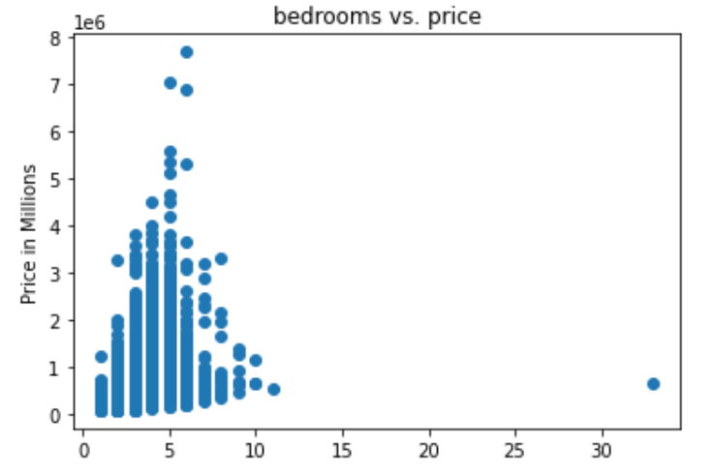
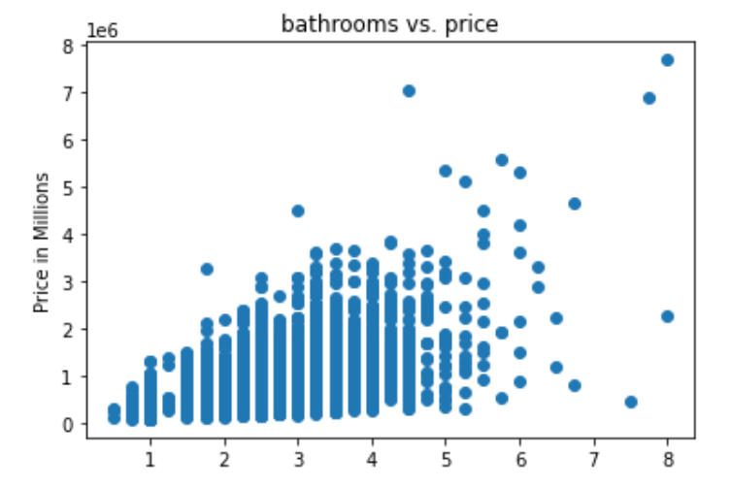
Price vs. Bedrooms | Price vs. Bathrooms
Notes:
Charts

